Slide 1



AUTOMATIC WATER LEVEL
CONTROLLER
PRESENTED BY :
DHARSHINEE S S (927623BEC036)
DURKA SRI N (927623BEC051)
ELAKKIYA K (927623BEC052)
ELAMATHI S (927623BEC053)

Slide 2
01
ABSTRACT
06
02
ADVANTAGES
INTRODUCTION
CONTENTS
07
03
IMPACT
COMPONENTS
08
04
CONCLUSION
CIRCUIT DIAGRAM
05
WORKING PRINCIPLE

Slide 3

01
01
ABSTRACT

Slide 4
ABSTRACT :
*This project presents an automatic water level controller circuit designed to manage the operation of a water pump based on tank water levels.
* Using a 555 timer IC, the system detects when the water level is low and turns on the pump.
* Once the tank is full, the pump is automatically turned off. This automated control system conserves water, optimizes energy use, and eliminates the need for manual operation, making it applicable for residential and industrial water management.

Slide 5
02
02
INTRODUCTION

Slide 6
INTRODUCTION :
An Automatic water level controller is a system designed to monitor and manage the water level in a tank without human intervention.
The primary objective is to ensure that the water pump operates only when necessary, preventing both overflow and dry running, which could damage the pump.
This circuit uses a 555 timer IC configured as a bistable multivibrator, along with sensors that detect the water levels at predefined high and low points in the tank.
When the water level falls below the lower threshold, the system triggers the pump to refill the tank.
Once the water reaches the upper threshold, the pump automatically turns off. This automation not only conserves water but also optimizes energy usage, making it ideal for home, agricultural, and industrial applications

Slide 7
03
03
COMPONENTS

Slide 8
Components with Functions :
IC 555 Timer: Functions as a bistable multivibrator for control.
BC 547 Transistor: Switches the relay.
12V Relay: Activates the water pump.
IN 4007 Diode: Protects the transistor from reverse voltage.
Resistors (1MΩ, 1kΩ): Set thresholds and limit current.
LED: Provides visual indication.
Water Level Sensors: Detect high and low water levels.

Slide 9
04
04
CIRCUIT DIAGRAM

Slide 10
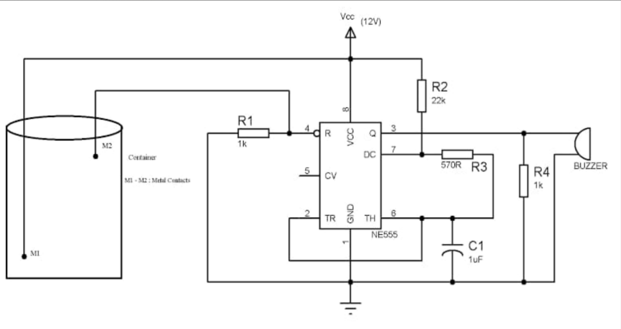
Circuit Diagram :

Slide 11
05
05
WORKING
PRINCIPLE

Slide 12
Working Principle :
Water Level Detection: Probes detect high and low water levels in the tank, with resistors determining corresponding voltage levels.
555 Timer Functioning : The 555 timer, acting as a bistable multivibrator, triggers the transistor and relay to activate the pump when water is low and deactivates it when the tank is full.
Relay Operation: The BC 547 transistor controls the relay, turning the pump on or off. The IN 4007 diode protects the transistor from voltage spikes during relay operation.

Slide 13
06
06
ADVANTAGES

Slide 14
ADVANTAGES :
Automatic Operation: Eliminates the need for manual control of water pumps.
Water Conservation: Prevents overflow and water wastage.
Energy Efficiency: Reduces energy consumption by running the pump only when necessary.
Pump Protection: Avoids dry running, extending the pump's lifespan.
Low Cost: Simple and affordable circuit design with readily available components.
Next

Slide 15
07
07
IMPACT

Slide 16
IMPACTS :
Residential Water Tanks: Automates water pump operation in households, ensuring consistent water levels.
Agriculture: Manages irrigation systems by controlling water levels in storage tanks.
Industrial Water Management: Used in factories for automated water refilling and drainage systems.
Commercial Buildings: Maintains water supply in overhead and underground tanks without manual intervention.
Flood Prevention: Helps regulate water levels in basements or low-lying areas to prevent flooding.
Next

Slide 17
08
08
CONCLUSION

Slide 18
CONCLUSION :
The automatic water level controller offers an efficient and cost-effective solution for managing water levels in tanks. By automating the pump operation, it conserves water, reduces energy consumption, and eliminates the need for manual intervention. The system ensures optimal water usage and protection for the pump, making it suitable for a wide range of applications in residential, agricultural, and industrial settings. With potential for further enhancements, such as IoT integration and additional monitoring features, this system provides a reliable foundation for smart water management.
Next

Slide 19


THANK YOU
Next

